Slide 1
Modern Machine Learning — K-means Initialization, Number of Centroids, & Learning Vector Quantization (LVQ)
Kenneth E. Barner
Department of Electrical and Computer Engineering
University of Delaware

Slide 2
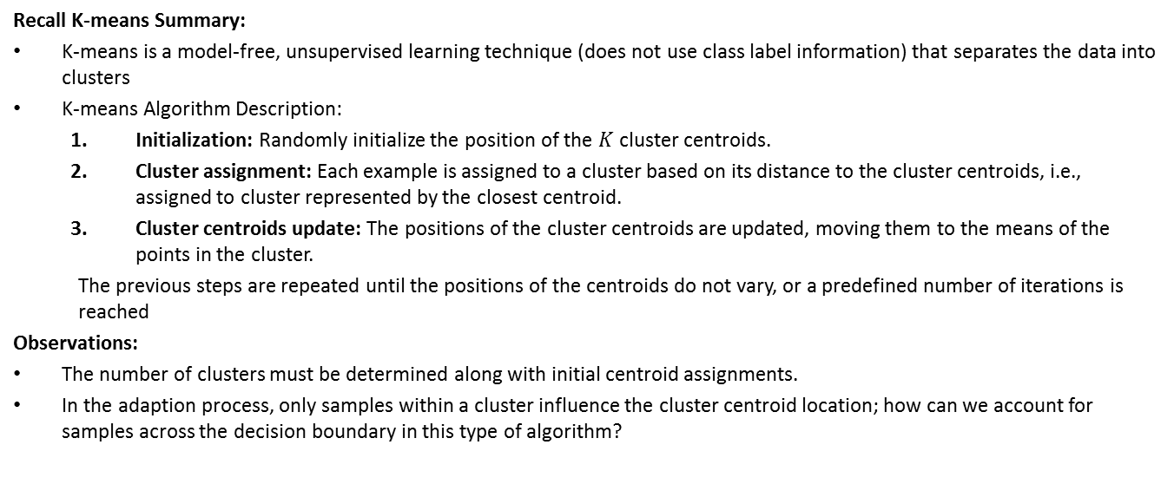
Initialization, # of Centroids & LVQ
Recall K-means Summary:
K-means is a model-free, unsupervised learning technique (does not use class label information) that separates the data into clusters
K-means Algorithm Description:
Initialization: Randomly initialize the position of the $K$ cluster centroids.
Cluster assignment: Each example is assigned to a cluster based on its distance to the cluster centroids, i.e., assigned to cluster represented by the closest centroid.
Cluster centroids update: The positions of the cluster centroids are updated, moving them to the means of the points in the cluster.
The previous steps are repeated until the positions of the centroids do not vary, or a predefined number of iterations is reached
Observations:
The number of clusters must be determined along with initial centroid assignments.
In the adaption process, only samples within a cluster influence the cluster centroid location; how can we account for samples across the decision boundary in this type of algorithm?

Slide 3
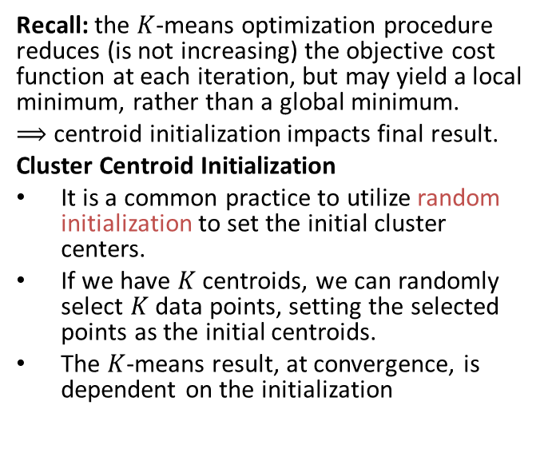




Initialization, # of Centroids & LVQ
Recall: the $K$-means optimization procedure reduces (is not increasing) the objective cost function at each iteration, but may yield a local minimum, rather than a global minimum.
$⟹$ centroid initialization impacts final result.
Cluster Centroid Initialization
It is a common practice to utilize random initialization to set the initial cluster centers.
If we have $K$ centroids, we can randomly select $K$ data points, setting the selected points as the initial centroids.
The $K$-means result, at convergence, is dependent on the initialization
$$x_{1}$$
Initialization 1 solution
$$x_{2}$$
$$x_{1}$$
Initialization 2 solution
$$x_{2}$$

Slide 4
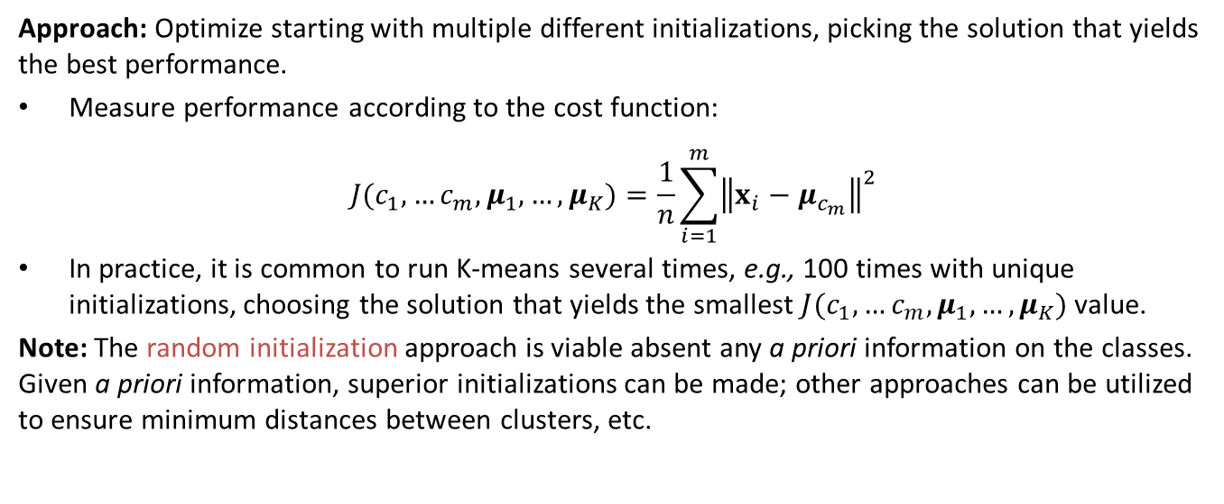
Initialization, # of Centroids & LVQ
Approach: Optimize starting with multiple different initializations, picking the solution that yields the best performance.
Measure performance according to the cost function:
$$J(c_{1},…c_{m},μ_{1},…,μ_{K})=\frac{1}{n}\sum_{i=1}^{m}{{\left\|x_{i}−μ_{c_{m}}\right\|}^{2}}$$
In practice, it is common to run K-means several times, e.g., 100 times with unique initializations, choosing the solution that yields the smallest $J(c_{1},…c_{m},μ_{1},…,μ_{K})$ value.
Note: The random initialization approach is viable absent any a priori information on the classes. Given a priori information, superior initializations can be made; other approaches can be utilized to ensure minimum distances between clusters, etc.

Slide 5




Initialization, # of Centroids & LVQ
Number of cluster centroids
To perform K-means, we need to determine the number of centroids, $K.$
The number of centroids may be given by a particular problem, but how do we choose $K$ if not known a priori?
Observation: There may be several ways to group the same data
$$x_{1}$$
$$x_{1}$$
$$x_{2}$$
$$x_{2}$$
Using K=2
Using K=4

Slide 6
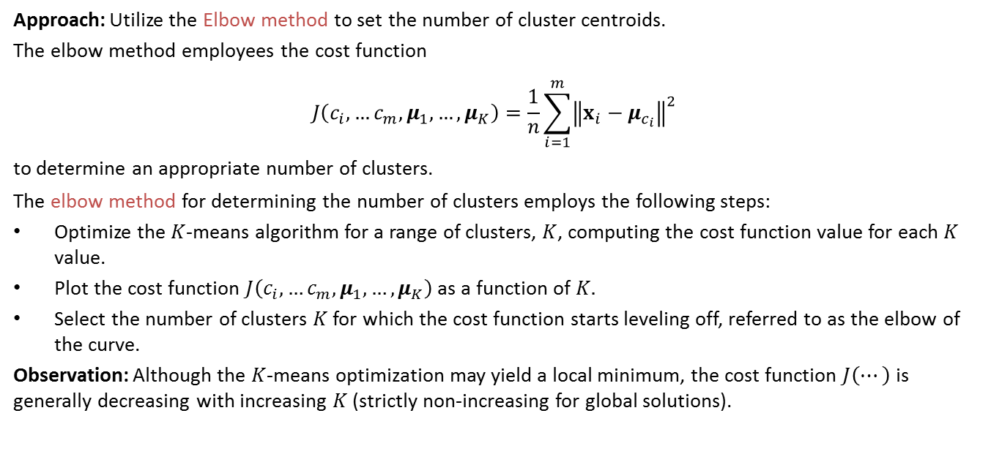
Initialization, # of Centroids & LVQ
Approach: Utilize the Elbow method to set the number of cluster centroids.
The elbow method employees the cost function
$$J\left(c_{i},…c_{m},μ_{1},…,μ_{K}\right)=\frac{1}{n}\sum_{i=1}^{m}{{\left\|x_{i}−μ_{c_{i}}\right\|}^{2}}$$ to determine an appropriate number of clusters.
The elbow method for determining the number of clusters employs the following steps:
Optimize the $K$-means algorithm for a range of clusters, $K$, computing the cost function value for each $K$ value.
Plot the cost function $J\left(c_{i},…c_{m},μ_{1},…,μ_{K}\right)$ as a function of $K.$
Select the number of clusters $K$ for which the cost function starts leveling off, referred to as the elbow of the curve.
Observation: Although the $K$-means optimization may yield a local minimum, the cost function $J\left(⋯\right)$ is generally decreasing with increasing $K$ (strictly non-increasing for global solutions).

Slide 7


Initialization, # of Centroids & LVQ
Elbow method graphically
Select the $K$ corresponding to the elbow in the graphic
Cost
Curve levels off
Elbow
$$K$$

Slide 8
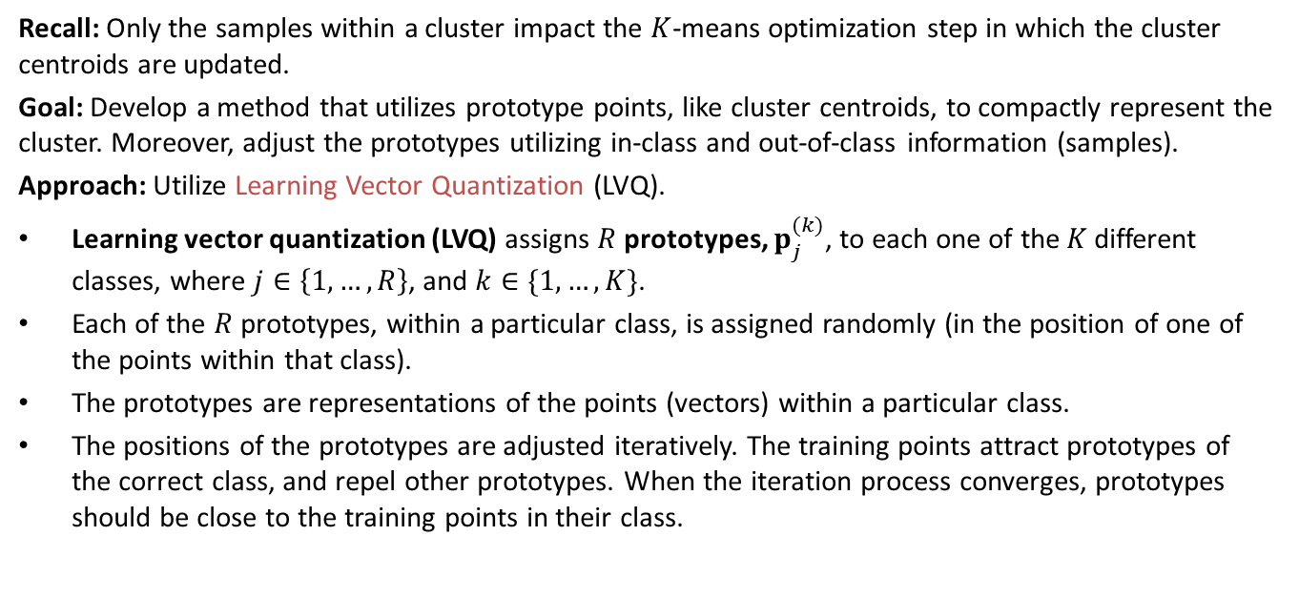
Initialization, # of Centroids & LVQ
Recall: Only the samples within a cluster impact the $K$-means optimization step in which the cluster centroids are updated.
Goal: Develop a method that utilizes prototype points, like cluster centroids, to compactly represent the cluster. Moreover, adjust the prototypes utilizing in-class and out-of-class information (samples).
Approach: Utilize Learning Vector Quantization (LVQ).
Learning vector quantization (LVQ) assigns $R$ prototypes, $p_{j}^{(k)}$, to each one of the$K$different classes, where $j∈\left\{1,…,R\right\}$, and $k∈\{1,…,K\}$.
Each of the $R$ prototypes, within a particular class, is assigned randomly (in the position of one of the points within that class).
The prototypes are representations of the points (vectors) within a particular class.
The positions of the prototypes are adjusted iteratively. The training points attract prototypes of the correct class, and repel other prototypes. When the iteration process converges, prototypes should be close to the training points in their class.

Slide 9
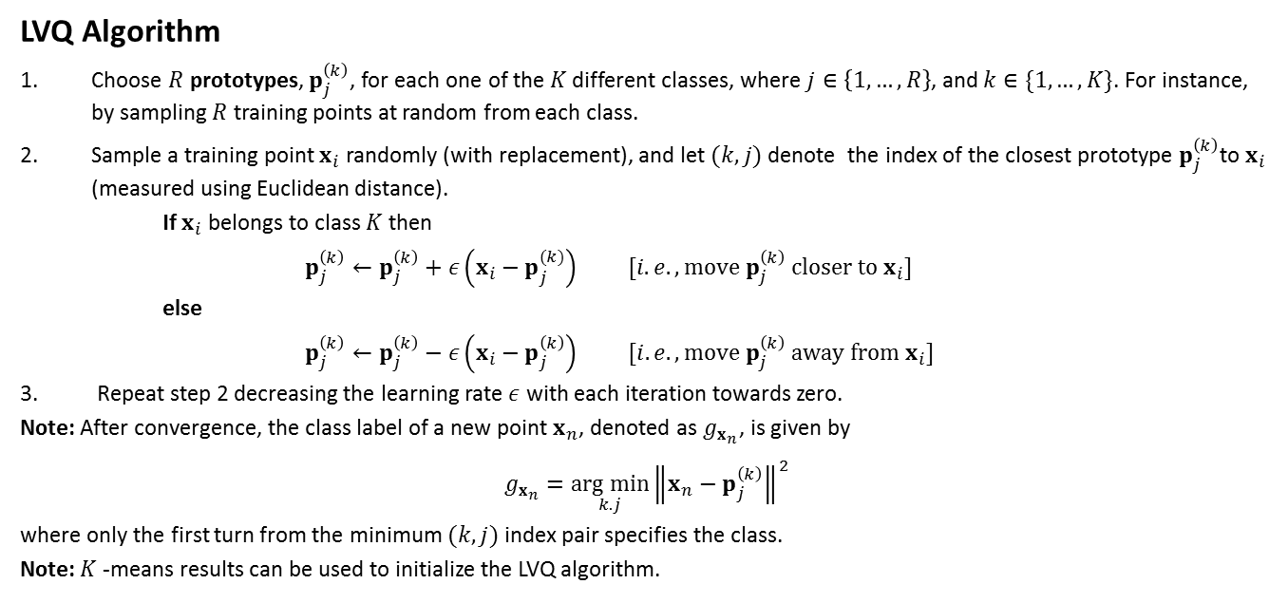
Initialization, # of Centroids & LVQ
LVQ Algorithm
Choose $R$ prototypes, $p_{j}^{\left(k\right)}$, for each one of the$K$different classes, where $j∈\left\{1,…,R\right\}$, and $k∈\{1,…,K\}$. For instance, by sampling $R$ training points at random from each class.
Sample a training point $x_{i}$ randomly (with replacement), and let $(k,j)$denote the index of the closest prototype $p_{j}^{\left(k\right)}$to $x_{i}$ (measured using Euclidean distance).
If $x_{i}$ belongs to class $K$ then
$p_{j}^{\left(k\right)}←p_{j}^{\left(k\right)}+ε\left(x_{i}−p_{j}^{(k)}\right) [i.e., move p_{j}^{\left(k\right)} closer to x_{i}]$
else
$p_{j}^{\left(k\right)}←p_{j}^{\left(k\right)}−ε\left(x_{i}−p_{j}^{\left(k\right)}\right) [i.e., move p_{j}^{\left(k\right)} away from x_{i}]$
Repeat step 2 decreasing the learning rate $ε$ with each iteration towards zero.
Note: After convergence, the class label of a new point $x_{n}$, denoted as $g_{x_{n}}$, is given by
$$g_{x_{n}}=\underset{k.j}{arg min}{{\left\|x_{n}−p_{j}^{\left(k\right)}\right\|}^{2}}$$
where only the first turn from the minimum $(k,j)$ index pair specifies the class.
Note: $K$-means results can be used to initialize the LVQ algorithm.

Slide 10
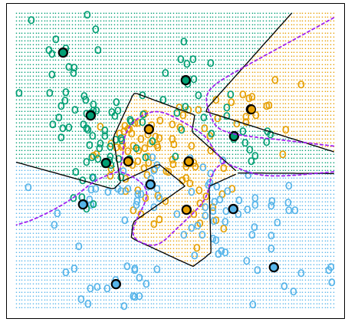
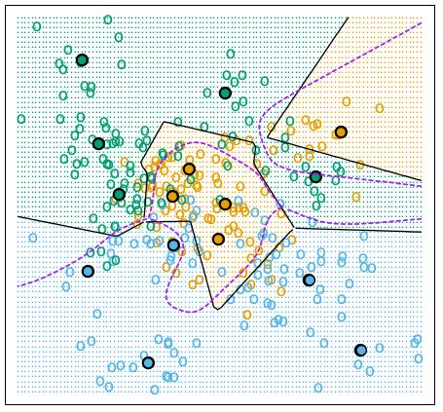
Example: Learning Vector Quantization
Example: Simulated data with three classes and five prototypes per class. Samples within each class follow a mixture of Gaussian distributions. Broken purple lines denote the Bayes decision boundary.
Observation: The LVQ boundaries more closely resemble the optimal Bayes decision boundaries.
(a) K-means, 5 Prototypes per Class
(b) LQA, 5 Prototypes per Class
Left Panel: The prototypes were obtained by applying the K-means clustering algorithm separately in each class.
Right panel: the LVQ algorithm, starting from the K-means solution, moves the prototypes away from the decision boundaries.

Slide 11
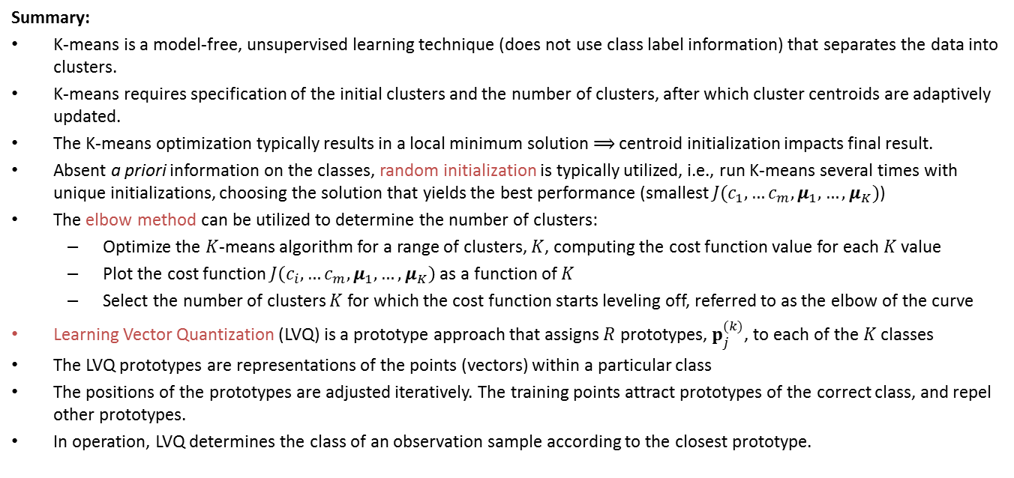
Initialization, # of Centroids & LVQ
Summary:
K-means is a model-free, unsupervised learning technique (does not use class label information) that separates the data into clusters.
K-means requires specification of the initial clusters and the number of clusters, after which cluster centroids are adaptively updated.
The K-means optimization typically results in a local minimum solution $⟹$ centroid initialization impacts final result.
Absent a priori information on the classes, random initialization is typically utilized, i.e., run K-means several times with unique initializations, choosing the solution that yields the best performance (smallest $J(c_{1},…c_{m},μ_{1},…,μ_{K})$)
The elbow method can be utilized to determine the number of clusters:
Optimize the $K$-means algorithm for a range of clusters, $K$, computing the cost function value for each $K$ value
Plot the cost function $J\left(c_{i},…c_{m},μ_{1},…,μ_{K}\right)$ as a function of $K$
Select the number of clusters $K$ for which the cost function starts leveling off, referred to as the elbow of the curve
Learning Vector Quantization (LVQ) is a prototype approach that assigns $R$ prototypes, $p_{j}^{(k)}$, to each of the$K$classes
The LVQ prototypes are representations of the points (vectors) within a particular class
The positions of the prototypes are adjusted iteratively. The training points attract prototypes of the correct class, and repel other prototypes.
In operation, LVQ determines the class of an observation sample according to the closest prototype.

